Slide 1


The first Hub for Developers
C# Fundamentals

Slide 2
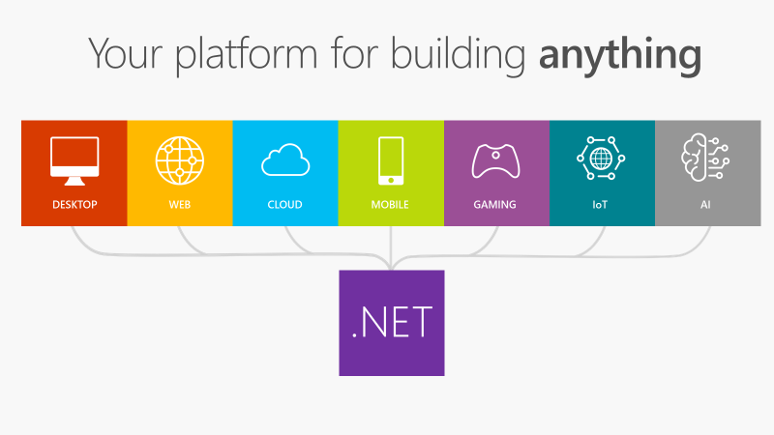

Slide 3
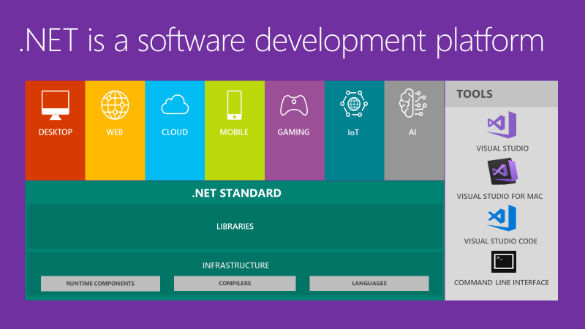
Notes:
.NET is an entire software development platform that takes care of a lot of the heavy lifting for you when you want to build an application. Applications frameworks help you build the specific types of apps or workloads and enable you to literally build any app for any platform with any operating system. Each .NET workload shares a common infrastructure and .NET Standard library. This means not only are your .NET skills portable, but your actual code is portable no matter what you’re building. This makes it easy to share reusable components (called libraries) across the breadth of applications people build.
Additionally, there are a broad set of development tools that makes it really productive to write, debug, build and manage code bases.

Slide 4
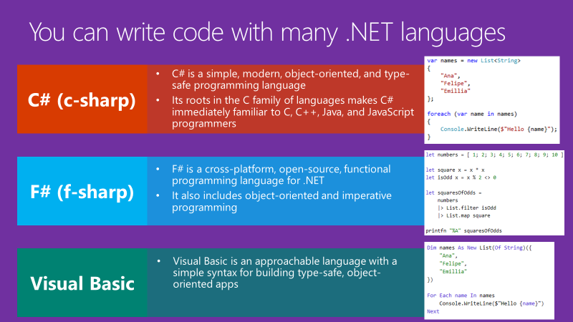

Slide 5
.NET is Fast. Really Fast!
2.22M
0.73M
requests / sec
0.53M
requests / sec
requests / sec
Java Servlet
.NET Core
Node.js
Data sourced from official tests available at TechEmpower Round 15.
“Using the same-size server, we were able to go from 1,000 requests per second per node with Node.js to 20,000 requests per second with .NET Core.“ — Raygun
https://www.microsoft.com/net/customers
Notes:
.NET is fast. Really fast! That means applications provide better response times and require less compute power. StackOverflow serves 5.3M page views a day on just 9 servers!
The popular TechEmpower benchmark compares web application frameworks with tasks like JSON serialization, database access, and server side template rendering - .NET performs faster than any other popular framework.
https://www.techempower.com/benchmarks/#section=data-r14&hw=ph&test=plaintext
The community has played a crucial role in performance work for the .NET stack.
https://blogs.msdn.microsoft.com/dotnet/tag/performance/

Slide 6
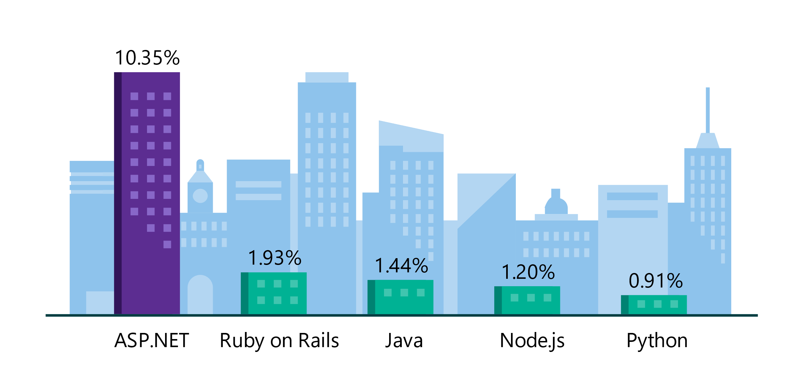
.NET is the platform of choice for the top 100K websites
More websites have been developed with ASP.NET than Ruby, Java, Python, Node.js, and Go combined.
Companies like Raygun, GoDaddy, and Tencent choose .NET for better performance, increased flexibility, and higher compatibility.
Data sourced from SimilarTech
Notes:
https://www.similartech.com/categories/framework
ASP.NET is the name of the web framework for .NET. As you can see there are more top websites developed with .NET than these other technologies. Only PHP has more.

Slide 7


.NET is Open Source
Community Accepted PRs
“Samsung is embracing .NET because it is a completely open source project.” — Samsung
".NET is open source; that allows us to contribute back to it if we have any performance issues which Microsoft review and together we make a better product.“ — Illyriad Games
16,000+ Community Contributions from 3000+ Companies outside Microsoft
Notes:
We’ve seen companies taking a bet on .NET because it’s a completely open source project. More than 16,000 contributors* from 3300 companies have contributed to .NET Core and related open source repositories, with over half of the contributions coming from outside Microsoft.
Samsung is a big partner and are releasing their new Smart TVs that support .NET. They plan to expand to all their IoT devices too. Illyriad Games, specifically Ben Adams, contributed many performance enhancements to the platform. They build a MMO with hundreds of thousands of concurrent users so performance is super important to them. These enhancements not only benefit them but everyone that uses .NET.
*contributor = Submitted a Pull Request or Created an Issue

Slide 8
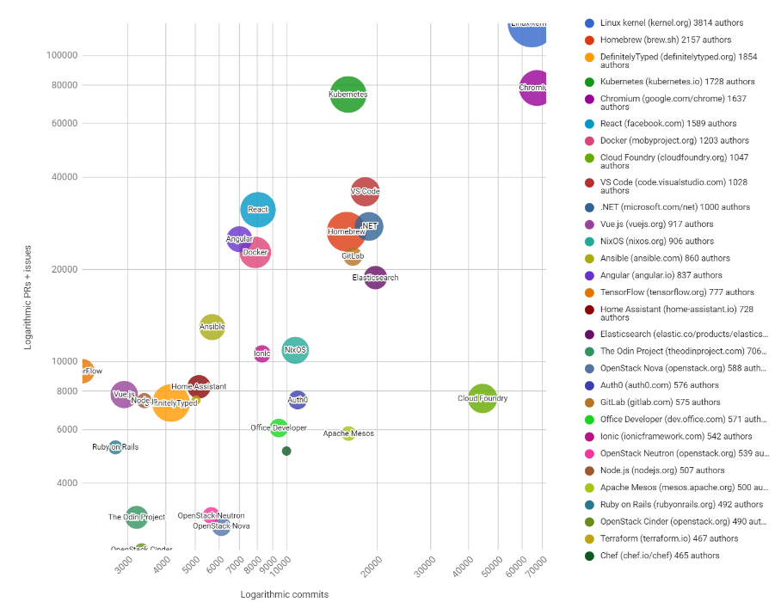

.NET named Top 30 Highest Velocity OSS Projects
https://www.cncf.io/blog/2017/06/05/30-highest-velocity-open-source-projects/
Notes:
Jim Zemlin, Executive director of Linux foundation said “There are 10’s of millions of open source projects, invest in the ones with sustainable ecosystems”. .NET is one of those projects. June 5th 2017, CNCF released an analysis of the top 30 highest velocity open source projects today. This is a logarithmic scale to measure OSS project velocity with commits on the X axis and PRs and issues on the Y axis, with # of authors indicated by the size of the circle. The farther upper right the more activity a project has. Linux Kernel is #1, followed by Chromium, Kubernetes and VSCode. Notice .NET is the #1 application framework.
Updated live: https://cdn.rawgit.com/cncf/velocity/d6f852d9/charts/top_30_bubble_chart_2017.html

Slide 9


.NET Open Source Journey
2001- ECMA-335
2002- .NET 1.0 for Windows released, Mono project begins
April 2014- .NET Compiler Platform (“Roslyn”) Open Source .NET Foundation founded
Nov 2014- .NET Core Cross-plat, Open Source
2008- ASP.NET MVC (web platform) Open Source
.NET
Aug 2017- .NET Core 2
2016- Mono project joins .NET Foundation
Notes:
This didn’t happen overnight. Here’s a little history of .NET open source…..
Dec 2001-Feb 2002.
A new platform is born. Along with HP, Intel and others, the ECMA-335 standard was created that defined a common language infrastructure to support multiple programming languages. C# and Visual Basic.NET were released and F# came later in 2007, but there are over 20 other .NET languages today. Visual Studio .NET was released and included C#, VB, C++ development all in one box. This was the first IDE that was truly integrated across multiple languages.
Mono project begins. The CLI spec gave others the ability to create their own .NET implementations. Even though Microsoft built the first .NET Framework for Windows-only, the spec was intentionally portable across OSes and chipsets. The Mono project began, spearheaded by Miguel de Icaza, with the goal to implement Microsoft's new .NET development platform on Linux and Unix-like platforms. Later, Miguel started Xamarin which focused on cross-platform, native, mobile development with C#, built upon Mono. This allows developers to use C# and .NET to build apps for iOS and Android. Unity games development also emerged from Mono.
2008.
ASP.NET MVC web development stack is released to CodePlex as open source. This was the first application development framework from Microsoft to be released as open source. The underlying runtime and compilers were still closed however.
2014.
Hell freezes over & pigs fly. Early 2014 at Microsoft’s BUILD conference, Anders Hejlsberg, the father of C#, releases the .NET Compiler Platform “Roslyn” as open source on stage. Later in November, .NET Core project begins in the open. The technology world is shocked, and the .NET community is excited. .NET Core is a new cloud-native implementation of .NET that is geared for cross-platform, hyper-scale services as well as small IoT devices. It’s meant to bring .NET into the next 15 years of computing. And the community has been extremely supportive.
2016.
Mono comes home. In early 2016, Microsoft finally acquires Xamarin and brings Miguel de Icaza into Developer Division. Mono joins the .NET foundation and is officially supported and contributed to by Microsoft. The Microsoft community officially meets the Mono community.
2017.
.NET Core 2.0 Released. Our cross platform and open source implementation of .NET finally releases to the world with unified tooling support across multiple operating systems and editors.

Slide 10


Slide 11
C# Genealogy
Object Oriented
Advanced Object Oriented
Elementary Procedural
Advanced Procedural
Special Procedural
Eiffel
Fortran
Algol 68
C
C++
C#
Cobol
PL/I
Pascal
Ada 95
Java
Ada 83

Slide 12
CLR
The virtual machine component of Microsoft's .NET framework
JIT
Just-In-Time compilation converts compiled code into machine instructions
Memory management
Type safety
Exception handling
Garbage collection
Security
Thread management

Slide 13
C# application building blocks
Assembly
a fundamental unit of physical code grouping
a "unit of deployment", almost always an .exe or .dll
Namespace
a fundamental unit of logical code grouping
using directive allows the use of a namespace

Slide 14
Namespaces
Permits isolation of names
Can be nested
Access via fully qualified names
Namespace CS415
Class A
Class B
Class C
Namespace CS340
Class A
Class B
Class C
CS415.A…
CS340.A…

Slide 15
Type System
Type should be consistent:
Predefined and user-defined
All C# types derive from System.Object
Single rooted hierarchy
Provides four standard methods:
bool Equals
int GetHashCode
Type GetType
String ToString

Slide 16
Types
Value types
Reference types
Nullable types
var keyword

Slide 17
Type casting
Implicit conversions – no syntax required
Explicit conversions – a cast operator is required because information might be lost

Slide 18
Selection statements
if - else if - else
switch

Slide 19
Cm to Inches
Your program should first ask the user if they want to convert inches to centimetres or centimetres to inches.
It should do this by displaying a prompt that looks something like this
Enter 1 to convert inches to centimetres or 2 to convert centimetres
to inches:
The program should then wait for the user to enter a number. If they enter 1, the program should ask for the number of inches, do the calculation and display the correct number of centimetres. If the user enters 2, the program should ask for the number of centimetres, perform the calculation and display the correct number of inches
If the user enters a value other than 1 or 2, an error message should be displayed.

Slide 20
Iteration statements
for
foreach…in
while
do…while
Jump statements
continue/break

Slide 21
Rock, Paper, Scissors
Write a program that lets the user play the game of Rock, Paper, Scissors against the computer.
The program should work as follows:
1. The computer generates a random number in the range of 1 to 3. If the number is 1, then the computer has chosen Rock. If the number is 2, then the computer has chosen Paper. If the number is 3, then the computer has chosen Scissors. Do not display the computer’s choice yet.
2. The user enters his or her choice of ‘rock, ‘paper’, ‘scissors’ or ‘quit’ at the keyboard.
3. If the user has entered ‘quit’, then continue at step 7.
4. The computer’s choice is displayed.
5. A winner is selected according to the following rules: a. If one player chooses Rock and the other player chooses Scissors, then Rock wins (The rock smashes the scissors) b. If one player chooses Scissors and the other player chooses Paper, then Scissors wins (Scissors cut paper) c. If one player chooses Paper and the other player chooses Rock, then Paper wins (Paper wraps rock) d. If both players make the same choice, then it is a draw.
6. Go back to step 1.

Slide 22
List<T>
A list of objects that can be accessed by index
Provides methods to search, sort, and
manipulate lists
Compared to array is easier to use and more flexible
var numbers = new List<int>()
{
5, 1, 3
};
numbers.Add(4);
numbers.Add(2);
numbers.Sort();

Slide 23
Dictionary<TKey, TValue>
A collection of keys and values
Duplicate keys are not allowed
var dic = new Dictionary<int, string>()
{
{ 1, "John" },
{ 2, "Chris" },
};
dic.Add(3, "George");
var isAdded = dic.TryAdd(3, "Mike"); // false

Slide 24
Linq
Language-Integrated Query
Deferred execution
IEnumerable<T>
ToList & ToArray
var numbers = new List<int>() { 1, 2, 3, 4, 5, 6 };
var evenNumbersQuery = from number in numbers
where (number % 2) == 0 select number;
foreach(var number in evenNumbersQuery)
{
Console.WriteLine(number);
}

Slide 25
Lambda expression
A lambda expression is an anonymous function that you can use to create delegates or expression tree types
Another way to write LINQ query exceptions
Lambda operator =>
var numbers = new List<int>() { 1, 2, 3, 4, 5, 6 };
var evenNumbersQuery = numbers
.Where(number => number % 2 == 0)
.Select(number => number);
foreach (var number in evenNumbersQuery)
{
Console.WriteLine(number);
}

Slide 26
Object Oriented Programming Principles
Inheritance is the ability to create a class that inherits attributes and behaviors from an existing class
Abstraction is the act of representing essential features without including the background details or explanations
Encapsulation refers to an object's ability to hide data and behavior that are not necessary to its user
Polymorphism is the ability of objects of different types to provide a unique interface for different implementations of methods

Slide 27
Class
A blueprint that defines the data and behavior of a type
Reference type
Static or non-static
class MyClass
{
}

Slide 28
Class
Instances can be created using the new
keyword → objects
Members
Fields
Constants
Properties
Methods
Constructors
public class MyClass
{
}
…
MyClass instance = new MyClass();

Slide 29
Class members - Fields
Fields are variables declared at class scope. A field may be a built-in type or an instance of another class
public class MyClass
{
int Age = 50;
}

Slide 30
Class members - Constants
Constants are fields or properties whose value is set at compile time and cannot be changed
They are stated with the use of the const
keyword
public class MyClass
{
const int Age = 50;
}

Slide 31
Class members - Properties
Properties are methods on a class that are accessed as if they were fields on that class. A property can provide protection for a class field to keep it from being changed without the knowledge of the object
The get keyword defines an accessor method in a property that returns the property value
The set keyword defines an accessor method in a property that assigns a value to the property
The set accessor has access to the value that client code is attempting to assign to the property by the use of the keyword value
Auto implemented properties {get; set;} can be used when accessors perform no other operation than setting or retrieving a value in a private backing field
public class MyClass
{
private string _firstName; public string FirstName
{
get
{
return _firstName;
}
set
{
_firstName = value;
}
}
public string LastName { get; set; }
}

Slide 32
Class members - Methods
Can exist only within classes
Can accept arguments
Can return values
Method overloading – multiple methods can exist for the same class but they must take different arguments
public long Add(int a, int b)
{
long result = a + b;
return result;
}
public void PrintSum(int a, int b)
{
long result = a + b; Console.WriteLine(result);
}

Slide 33
Class members - Instance constructors
public class MyClass
{
A method that is called whenever the class is created
Has the same name as the class
Constructor overloading - multiple constructors can exist for the same class but they must take different arguments
Used to initialize members of the class
private string _first; private string _last;
public MyClass(string first)
{
_first = first;
_last = "Doe";
}
public MyClass(string first, string last)
{
_first = first;
_last = last;
}
}
…
MyClass instance1= new MyClass("John");
MyClass instance2 = new MyClass("John", "Smith");

Slide 34
static class
static keyword
All members are shared by all instances of a
class
No instances can be created
All members must be static
Access the members of a static class by using
the class name itself
Cannot contain instance constructors
Cannot be inherited or inherit
public static class MyClass
{
static int _multiplier = 10;
public static long TimesTen(int input)
{
return input * _multiplier;
}
}
…
MyClass.TimesTen(5);

Slide 35
Method overloading
Many methods with the same name but different signature
Compiler decides which method to call based on the arguments passed matching the method with the same signature
public void SayHello(string firstName)
{
Console.WriteLine($"Hello {firstName}!");
}
public void SayHello(string firstName, string LastName) Console.WriteLine($"Hello {firstName} {LastName}!");
{
}
…
SayHello("John");
// outputs "Hello John!"
SayHello("John", "Smith");
// outputs "Hello John Smith!"

Slide 36
Access Modifiers
public : Access is not restricted
protected : Access is limited to the containing class or types derived from the containing class
internal : Access is limited to the current assembly
protected internal : Access is limited to the current assembly or types derived from the containing class
private : Access is limited to the containing type
private protected : Access is limited to the containing class or types derived from the containing class within the current assembly

Slide 37
Fahrenheit to Celcius
The formula for converting a temperature from Fahrenheit to Celsius is:
C = 5/9(F – 32)
where F is the temperature in Fahrenheit and C is the temperature in Celsius.
Write a class called TemperatureConversion that includes methods that:
• Convert Celsius to Fahrenheit. The Celsius temperature is passed as a parameter and it returns the corresponding Fahrenheit temperature.
• Convert Fahrenheit to Celsius. The Fahrenheit temperature is passed as a parameter and it returns the corresponding Celsius temperature.
Demonstrate the methods by using loops to display the Fahrenheit temperatures 32 through 212 and their Celsius equivalents and the Celsius temperatures between 0 and 100 and their Fahrenheit equivalents.

Slide 38
OOP - Inheritance
A class can inherit another class’ properties, members and methods.
virtual keyword states that a base class method can be overridden using override keyword

Slide 39
OOP - Inheritance
A class can be marked as abstract using the abstract keyword
An abstract class can contain abstract methods that have no implementation, just the signature
Classes inheriting from abstract classes must implement the abstract methods using the
override keyword

Slide 40
OOP - Inheritance
A class can inherit from on or more interfaces
An interface can inherit from one or more interfaces, but cannot inherit a class

Slide 41
OOP – Abstraction
Hiding implementation using abstract classes and interfaces

Slide 42
OOP - Encapsulation
Hide implementation details using access modifiers and accessors

Slide 43
OOP - Polymorphism
Static polymorphism achieved through method overloading
Dynamic polymorphism achieved through virtual methods and overrides of them

Slide 44
Inteface
A contract that all the classes inheriting the interface should follow.
An interface contains only the signatures of
methods, properties, events or indexers.
A class that implements the interface must implement the members of the interface that are specified in the interface definition
public interface IMyInterface
{
void Print(string input);
long Add(int a, int b);
}

Slide 45
Exception handling
Exception is an error that arises during the execution of a program
try…catch…finally keywords are used to capture an exception and handle it appropriately
finally block is always executed
finally is optional
throw keyword “throws” an exception
try
{
var zero = 0;
var result = 10 / zero;
}
catch (Exception ex)
{
Console.WriteLine(“Cannot divide by zero!");
}
finally
{
Console.WriteLine("finally");
}

